Slide 1
Expectations for Cloud Ready Applications
Ranjan Prasad and Brian Rieger
Day, Month Year

Slide 2
Cloud Ready Applications
Ranjan Prasad

Slide 3
Health Care Cloud | What is Cloud Readiness?
Cloud Readiness Introduction
The Cloud Roadmap
“Cloud Readiness represents the Maturity of an organization, to identify Appropriate Cloud-services, which Generate value. Cloud-services have to be integrated efficiently and target oriented
Within enterprises in order to be able to Manage their use and allows the agile change of Cloud-Service provider”
Cloud Need Identification
Cloud Readiness Assessment
Risk & Benefit
Analysis
Business Case
Cloud Strategy
Transformation Roadmap
“Today’s best Practices are tomorrow’s anti-patterns.”

Slide 4
Need for Cloud Ready
Customer expects it
Gives you more business options
Your competitors are doing it
Meet demand to operate at scale
It makes everyone happier

Slide 5
Assess Your Cloud Readiness
General guidance to help make the pre-migration planning
A Business Case for Cloud Migration
Estimate Timeline and Budgets
Establish a Cloud Operating Model
Assess relative complexity and risk of migrating a service to a cloud solution
Determine which of the 6 "Re-s" are most appropriate for this services:
Remove/Retire
Retain: Keep in a DC, somehow
Repurchase
Rehost
Replatform
Refactor/Rewrite
Notes:
https://github.com/18F/cloud-assessment/blob/master/assessment.md

Slide 6
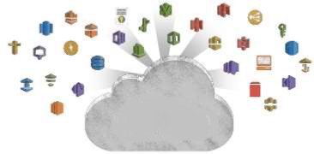

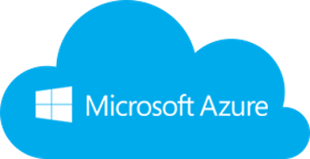
There are many reasons to move to the Cloud
Why? What? How ?
Agility
Platform Breadth
Cost Savings and Flexibility
Continual Iteration and Innovation

Slide 7
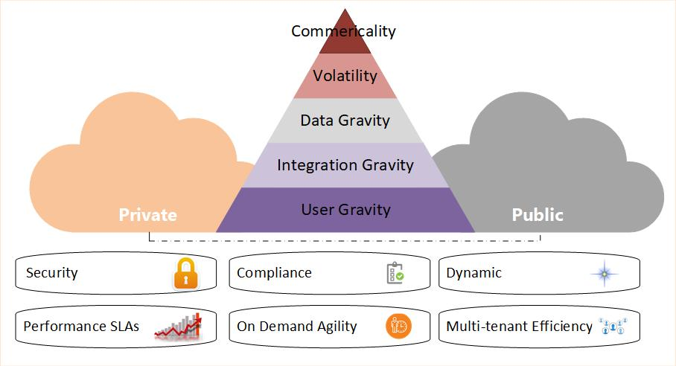
There are many reasons to move to the Cloud
Why? What? How ?
What workloads can be moved to the cloud:
Strategy & Business Goals: Applications, Processes, Data & Storage “SaaS, IaaS, PaaS”
What are the business priorities?
What technology is the business using?
What are the usage requirements?
What is the budget?

Slide 8




There are many reasons to move to the Cloud
Why? What? How?
Cloud Assessment
Phase
Proof of Concept
Phase
Data Migration
Phase
Application Migration
Phase
Leverage the Cloud
Phase
Optimization
Phase
Assess Cost
Assess Architecture
Assess Security
Learn Azure, K8s…
Build a Pilot
Build support within your Org
Leverage different Storage Options
Migrate
Forklift Migration
Strategy
Hybrid Migration Strategy
Auto-scaling
Automation
Elasticity
High-Availability
Utilization
Monitoring
Efficiency
Performance
Re-engineering
What you’ll need in this journey
Cloud Eng. Team
Training
Enterprise Support model
Discovery & Assessment Process defining the roadmap, quick wins and adoption plan
TCO analysis and business case
Business benefits and value analysis
Cost of migration and execution plan
Technology assessment
Security assessment
Portfolio evaluation
Technology partners
You’ll need a guide
You’ll need a map
You’ll need a reason
You’ll need tools

Slide 9
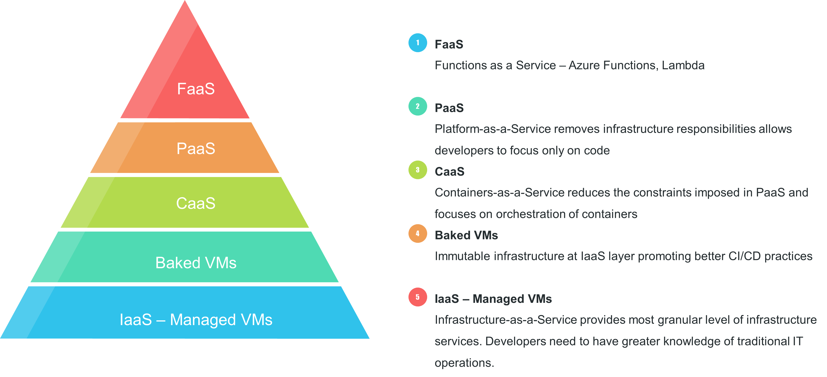
Cloud Compute Layers

Slide 10
Cloud-Native
Apps Characteristics
Visible
Ability to measure a service in your cloud
Disposable
Services do not maintain state and can be removed at will
Repeatable
Mature CI/CD pipeline produces predictable builds and deployments
Follow 12-factor
Applications adhere to the 12-factor app
Secure
Applications know how to utilize AuthN and AuthZ
Distributed
New Services can be found & accessed through a decoupled communication interface
Performant
Applications are built to emphasize boot-up speed and focus on resource needs

Slide 11
What is cloud-native all about?
This is an approach to building and operating software that takes advantage of the cloud-computing delivery model. Often seen as a combination of microservices, continuous delivery, containers, and DevOps.
It’s all about software that’s built for scale, built for continuous change, built to tolerate failure, built for manageability.

Slide 12
Health Care Cloud | Cloud Readiness Vs Cloud Native
There is a maturity model to cloud native
Cloud Ready
Cloud Friendly
Cloud Resilient
Cloud Native
No File System Dependency
Self contained application
Platform managed ports/address
Consume off-platform services
Twelve factor app
Horizontal scalable
Leverage Platform for HA
Designed for failure
Apps unaffected by dependencies
Proactive failure testing
Metrics and monitoring baked in
Cloud agnostic runtime
Microservices architecture
API-first design

Slide 13
12 Factor Application
Brian Rieger

Slide 14
What is Serverless?
Traits of Serverless (function as a service)
No Server Management
Performance capabilities
AutoScale
High Availability
Precise Costs
3factor Application
Factor #1
Realtime GraphQL
Factor #2
Reliable eventing
Factor #3
Async Serverless
Notes:
Ref: https://3factor.app/

Slide 15
The 12 Factors
Codebase
Dependencies
Config
Backing Services
Build, Release, Run
Processes
Port Binding
Concurrency
Disposability
Dev/Prod Parity
Logs
Admin Processes

Slide 16
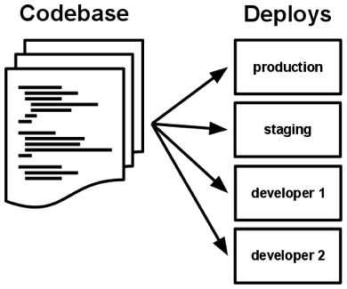



#1 & 2 Codebase and Dependencies
Codebase
One Codebase should be used to track all changes to the application such as Git or SVN
Each Codebase can have numerous different deploys for all of the environments needed
Dependencies
Should be explicitly declared and isolated
Handled by common tools such as Gradle or Maven
Eliminates Dependency on system-level tools or libraries.

Slide 17
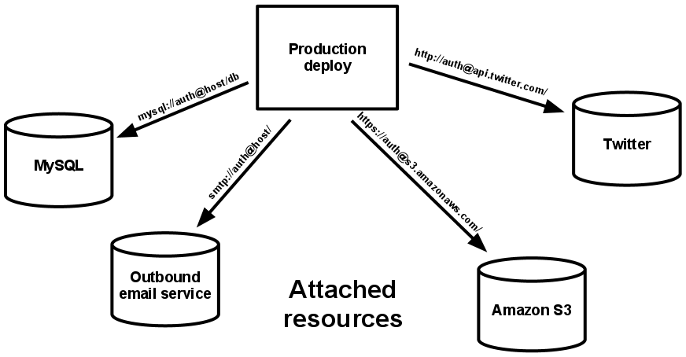
#3 & 4 Config and Backing Services
Config
Should be stored within environment variables
Backing Services
Think of backend databases, caches, etc. as attached resources that are configurable.
Code should be agnostic of the backend
Easily switch between different types of database with no code change
Notes:
https://github.optum.com/OPTUMSource/blank/blob/master/web/src/main/resources/application.yml
https://github.optum.com/DataExternalization/eligibility-api-consumer/blob/master/src/main/resources/application.yml#L143 and https://github.optum.com/DataExternalization/eligibility-api-consumer/blob/master/osedeploy.yaml#L92

Slide 18
#5 & 6 Build, Release, Run and Processes
Build, Release, Run
Build – Code that has been compiled and has all of the needed dependencies downloaded by the dependency manager
Release – A release combines the built code with the current deployments configuration.
Run – An app running in an execution environment that is comprised of numerous processes
Processes
Execute the app as one or more stateless processes
Any data that needs to be persisted should use a persistent data backend

Slide 19
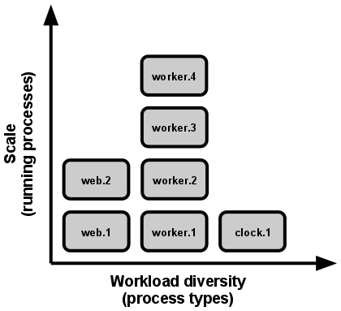
#7 & 8 Port Binding and Concurrency
Port Binding
Each Application should be bound to a specific port so that it can be easily accessed by other applications
Should not rely on a runtime injection of a webserver
If one app is a backing service for another app the details on this port can be stored within the config.
Concurrency
Duplicate processes can be spun up and load can be split across them.
Container Orchestration Engines Handle a lot of this for you (Kubernetes, Openshift, Azure)
Notes:
https://github.optum.com/DataExternalization/eligibility-api-consumer/blob/master/osedeploy.yaml#L245

Slide 20
#9 &1 0 Disposability and Dev/Prod Parity
Disposability
In a containerized world containers can move to a different physical node at any point
SIGTERM can be utilized when a graceful shutdown happens
Use queues to deal with application crashes
Dev/Prod Parity
Time Gap – Within hours or minutes after a developer writes code it should be deployed to production
Personnel Gap – A developer who writes code should be involved during the deployment and also monitor the applications behavior
Tools Gap – Tools used in a development environment should be identical to those used in production. In a containerized world this is very possible.
Notes:
https://github.optum.com/gist/aaronkorver/3f130bb388766ee95441f09a70e0f82b

Slide 21


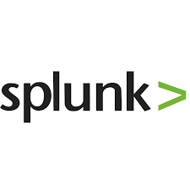
#11 & 12 Logs and Admin Processes
Logs
Should be an event stream
Send them to stdout and stderr for aggregation
Have a collector running such as Fluentd or Filebeat that ships the logging over to an analytics tool such as Splunk or Elasticsearch
Admin Processes
Run admin/management tasks as one-off processes
Keep admin tasks in source control and packaged alongside the application

Slide 22
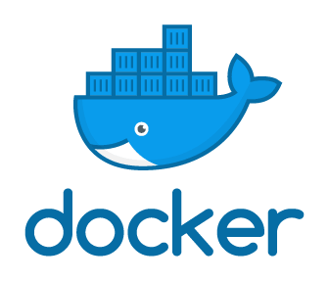


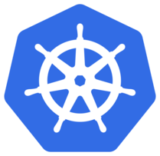
Deploying a 12 factor app into OSFI Kubernetes
Store Version
Web App
ISCSI Block Storage - Flash
NFS NAS/Flash
Application Code
Kubernetes Yamls
Dockerfiles
Jenkinsfiles
Create and test build pipeline
Database
Run Deployment
API

Slide 25
Health Care Cloud Overview
Ranjan Prasad

Slide 26
Health Care Cloud | Enterprise Cloud Strategy
Enabling teams to deliver value safely, quickly and sustainably in the Healthcare Cloud. Providing for an orderly adoption of Healthcare Cloud services with visibility into who is utilizing, what is being used, how much we are spending, and what risks we are being exposed to.
Internal Business Partners
Internal Technical Partners
UHG- Enterprise
External Clients
Vendors
Offering Choices with flexibility & Agility in the offerings and bundling of those offerings.
Lowest cost option regardless of platform.
No vendor lock-in.
Ease to scale and agility to chose when.
Education and strategy considerations.
End to end audit and compliance traceability.
Agile & proactive approach to development of modules.
Solutions pre-assembled via business portfolio (i.e. Data analytics).
Provide a library of reusable modules.
Inner-Source/ Coaching/Training materials& opportunities.
Security Framework with no interruption to application or services.
Delivering Value at the lowest risk to the business.
Meetings Compliance & Security Policies.
Monitoring/ remediation/ reporting on risk.
Offering out services priced to break-even.
Multiple Vendor Options to meet various business needs across the organization.
Multi-channel/market approach consolidates investment in common platforms/ services & capabilities.
Product interoperability existing CSP security and compliance.
Cost Savings by leveraging power in numbers.
IaaS/PaaS strategy.
Help vendor maximize cost/value proposition
New Vendor Service models:
Micro-service injections
Blended data/code ownership
New life cycles
Partners
Notes:
Leverage cloud technology to dramatically reduce time to deploy and slash cost of operation for existing applications.

Slide 27

Health Care Cloud | Team Maturity Expectations
Level 0
Level 1
Level 2
Level 3
Level 4
Level 5
Source code management
using Git, EGH and Pull Requests
Partially automated test/build process (CI) (e.g. Jenkins)
Fully automated test/build process (CI) (e.g. Sonar)
Partially automated deployment process (CD)
Logging/Monitoring in place across all env’s (e.g. Ruxit)
Service based (API-centric) design leveraging containers
IAC in place as part of the CI/CD pipeline (e.g. Chef)
Serverless UI/Single Page Web App (SPA)
API calls routed through public cloud edge networks or using cloud based DNS configuration
Reality: teams are not at the expected maturity level needed to move to the cloud. Expectation: Only teams/apps at Level 5 consider migrating to Public Cloud with confidence.
Data and API/Service/ Business Logic tiers migrated to public cloud platform

Slide 28



Health Care Cloud | Who moves to the Public Cloud?
Application Categories
Even if a team demonstrates readiness for the public cloud, it does not entitle them to deploy to the public cloud.
Teams must demonstrate a use case for the Public Cloud offerings based upon one or more of the following criteria:
Commerciality: The application or service is intended for external commercial uses. Commercial applications, or apps that are used externally that have the potential for “viral” user uncertainty, are good candidates for public cloud (with proper scaling).
Volatility: Applications that have very high load peaks compared to its average, also known as seasonality of the workload. We need to manage the volatility on the public cloud to ensure we do not impact other services and reduce cost if planning for the worse case.
Data Gravity: Big data is difficult, costly and time consuming to move back and forth between data centers. Application requiring a large amount of data should be hosted close to the data.
Integration Gravity: Applications that are deployed to public cloud should not have multiple dependencies on integrations located in the Optum data center. Integration should only be through streaming methods or API.
User Gravity: If the users are all in the UHG network (and if the data is all in the data center), then the application should be hosted in the Optum Data Center.
PII/PHI: The presence of PII/PHI is a factor used when evaluating workload placement, but it is not the only criteria. The volatility of the workload and data gravity has more weight when making workload placement. Additionally, the controls in place assume the presence of PII/PHI and the controls are mandatory.

Slide 29

Cloud | Private Cloud Journey Team Experience
Dev. Team Cloud Journey
Crawl
Walk
Run
Marathon
Cloud Aligned
Portfolio/Application on Cloud Readiness
Team Maturity Assessment
Revise Architecture- Modernized
Leverage Training Materials
Engage Sprint 0 team
Cloud Enabled
Cont’d Training/ Coaching
Onboard to Non-Prod
Finalize Target Architecture
POC /Pilot
Cloud Ready
Immutable Containers
CI/CD & gitops
Decouple the data
Design for scaling
Observability
Cross Cloud
Multi-cluster deployment
True devops
Serverless if applicable
Mature operation
Self-healing application
Advanced data management
0-1 month 1-3 months 3-6 Months 6-8 Months

Slide 30
Cloud | Public Cloud Journey Team Experience
Dev. Team Cloud Journey
Crawl
Walk
Run
Marathon
Cloud Aligned
Portfolio/Application on Cloud Readiness
Team Maturity Assessment
Revise Architecture- Modernized
Leverage Training Materials/ Workshops/ Redbox
Engage Coaching Team
Cloud Enabled
Cont’d Training/ Coaching
Develop in Redbox
Finalize Target Architecture
Leverage Automated Modules
POC Ready
Cloud Ready
Immutable Infrastructure
IAC/ EAC
CI/CD
API Calls
Cross Cloud
Use Self-Service CSP selection based on Client Needs/Price
Zero Trust Networking is Realized
Serverless is Common practice
Machine Learning Applied to Operations
2-4 months. 4-6 months. 6-9 Months TBD

